Slide 1
Police complaints
Statistics for England and Wales 2022/23
(experimental statistics)

Slide 2
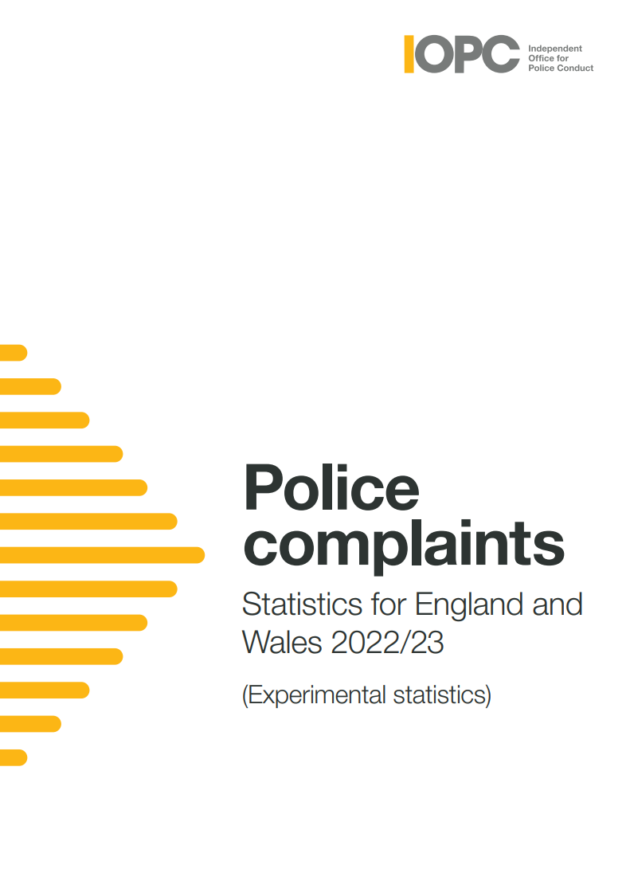
Introduction
Our police complaints statistics reports include information about the number and type of complaints made.
They also set out how these complaints were subsequently dealt with and include demographic data about who complained and who the complaint was about.

Slide 3
Complaints logged
Between 1 April 2022 and 31 March 2023 police forces logged 81,142 complaints, an 8% increase on the previous year.
Forces took on average five working days to log complaints from the date the complaint was made. This is a four-day improvement on the nine days taken in 2021/22.
The number of complaints recorded formally fell again in 2022/23 to 31,620 (a drop of almost 12% from 35,738 last year).
Figures show that forces finalised more complaints informally in 2022/23 and more notably, that the timeliness of informal handling improved by more than a week (from 5 weeks / 24 working days in 2021/22 to 4 weeks / 18 working days in 2022/23).

Slide 4
Types of complaint
The 2022/23 complaints contained 134,952 allegations.
The largest proportion of allegations logged continues to relate to “delivery of duties and service” (55%).
The next highest proportions are for “police powers, policies and procedures” (20%) and individual behaviours (13%). “Discriminatory behaviours” and “damage to property” make up 3% each of allegations logged.
A total of 4,062 allegations of ‘discriminatory behaviour’ were logged, accounting for 3% of all allegations logged in 2022/23. This ranges from less than 1% to 6% of allegations logged across individual forces.

Slide 5
Types of complaint
As we have seen in previous years, the proportion of sexual conduct allegations logged is less than 1%.
In 2022/23, we saw a small decrease in allegations logged as “other”. This may indicate improvement in the categorisation of allegations.
There was a notable increase in “discreditable conduct” allegations logged in 2022/23 – a 19% increase on the number logged in 2021/22. The “discreditable conduct” category covers behaviours that occur while not in the execution of a police employee’s duty, but that speak to their conduct as a person serving with the police. It can also include activity while on duty that is not in execution of their duty, such as theft where this is not an abuse of position.

Slide 6
Complainants and those complained about
There have been some improvements in capturing data about those that are complaining. Those not answering the ethnicity question has dropped by five percentage points compared to last year.
74,543 people complained about the police of whom 51% of the complainants were men. The most common age group to complain were those aged 30-39 (21%). 55% of all complainants were White, however the ethnicity of 31% of complainants was unknown.
51,720 people serving with the police were subject to a complaint. 62% of those complained about were men, 80% were White and 14% where the ethnicity was not known.

Slide 7
Complaint outcomes (allegations and cases)
The majority of allegations handled formally other than by investigation found that the service provided was acceptable (67%).
Almost a quarter (24%) of allegations investigated under special procedures resulted in a case to answer decision.
The IOPC has worked closely with forces to improve data quality of recording actions on formally recorded complaints. This has now improved and the number of cases with an explanation, debrief or apology have increased.

Slide 8
Complaint outcomes (allegations and cases)
Of the 30,521 complaints handled formally in 2022/23, 53% had at least one allegation resulting in an explanation, debrief or apology (43% in 2021/22). 40% resulted in no further action being taken (48% in 2021/22).
113 of those cases had at least one allegation resulting in either a misconduct meeting or hearing, compared to 68 in 2021/22 and 18 in 2019/20.
92% of allegations handled informally were either resolved to the satisfaction of the complainant and/or the complainant did not wish to pursue their complaint formally.
The most common action resulting from complaints handled informally was an explanation being given to the complainant (58% of complaints). 21% of complaints handled informally resulted in at least one allegation having no further action.

Slide 9
Reviews
Reviews are handled by the appropriate review body, which is either the IOPC or the Local Policing Body (LPB).
LPBs upheld 19% of the 4,093 complaints they reviewed that had not been investigated and 27% (156 out of 574) of those that were investigated.
The IOPC dealt with 1,500 reviews and upheld 44% of those that had not been investigated and 32% of those that had.

Slide 10
Find out more
The full report is available on our website www.policeconduct.gov.uk.
Simply go to the Publications Library in the top menu, and search for ‘Police complaints statistics’. Previous years’ reports are also available.
If you have any questions about the report please email oversight@policeconduct.gov.uk

